Slide 1

Intro to Xamarin
Developing Native iOS, Android, & Windows Apps with C# & XAML
Dipesh Trikam

Slide 2

MVVM Pattern
Views
UI – How to display Information
View
Platform Specific
Data Binding
View Models
What information to display
Flow of interaction
View Model
Reference
Portable
Models
Data Entities
Model

Slide 3
Architecture
Visual Appearance
Behaviour
XAML
Code-Behind

Slide 4
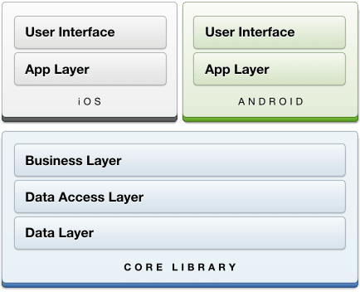
Architecture

Slide 5
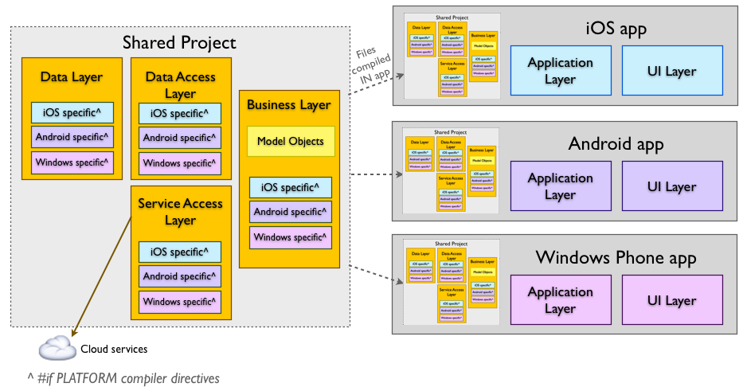

Slide 6
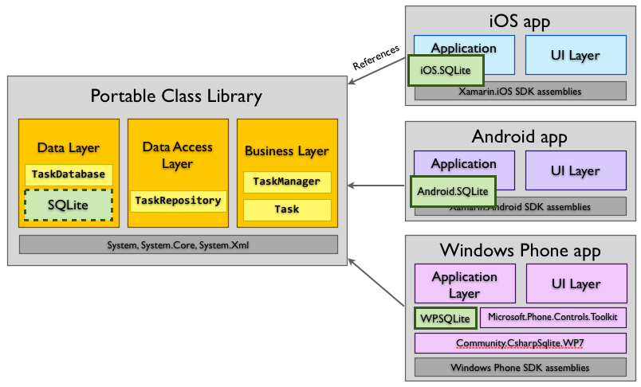
Notes:
Benefits
There are some great benefits for using PCL’s
Easier unit testing
Easier to read code
Greater Portability
Better implementations of code

Slide 7


Slide 8
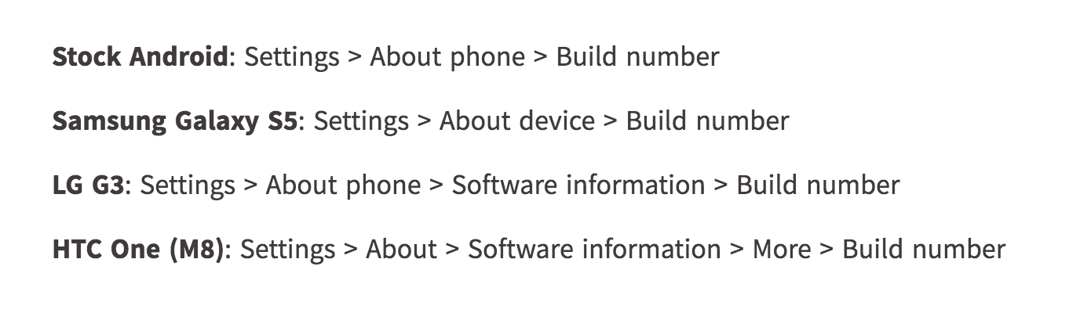
Developer Options (Android)
Notes:
Tap about seven (7) times. After the third tap, you'll see a playful dialog that says you're four taps away from being a developer. (If only it were that simple, eh?) Keep on tapping, and *poof*, you've got the developer settings back.

